Slide 1
Manufacturing and Service Operations MSO 40.012
R Desmicht – Adjunct Professor SUTD

Slide 2
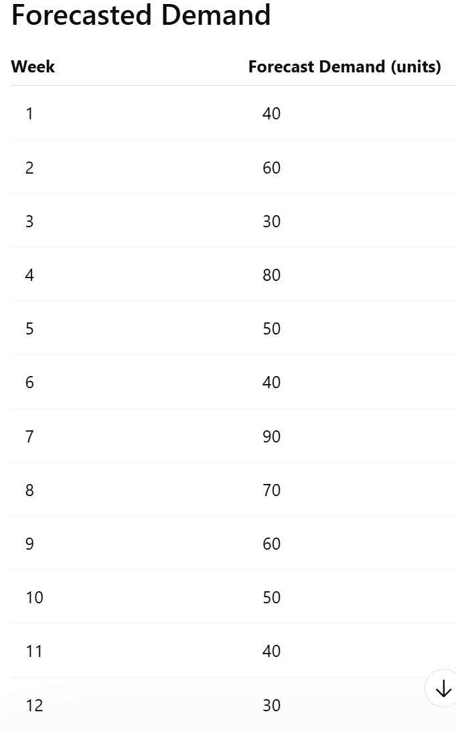
MPS
A factory produces a specialized industrial pump component.
The production planner must prepare a Master Production Schedule (MPS) for the next 12 weeks.
The company has the following characteristics:
Initial inventory: 50 units
Weekly inventory holding cost: €2 per unit per week
Set-up cost per production run: €400
No shortages are allowed
Production occurs at the beginning of the week
Demand occurs during the week
Safety stock is not required

Slide 3
MPS: lot for lot
Build a 12-week MPS table including:
Forecast demand as provided
Beginning inventory
Production quantity
Ending inventory
Set-up cost
Inventory holding cost
Calculate:
Total number of production runs
Total set-up cost
Total inventory holding cost
Total cost
Week | Demand | Beginning Inventory | Production Qty | Ending Inventory | Set-up Cost | Holding Cost
1 | 40 | 50 | 0 | 10 | 0 | 20

Slide 4
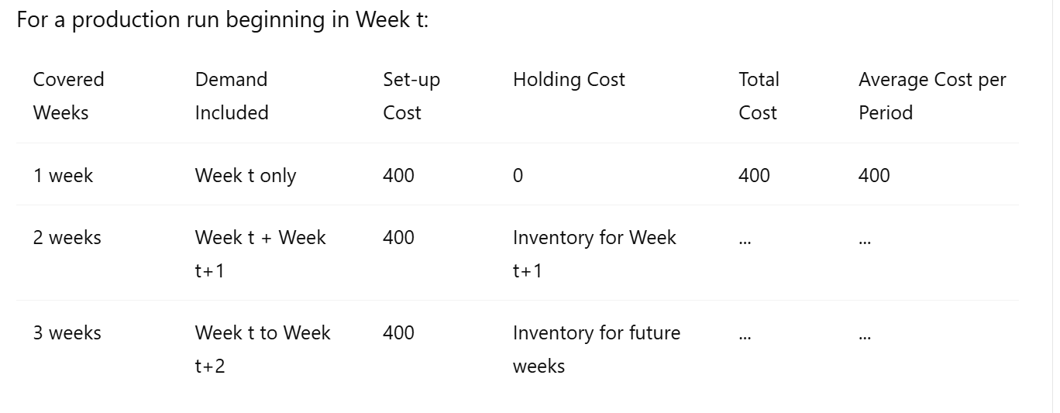
MPS: Silvermeal
Starting in Week 1, determine how many weeks of demand should be included in the first production batch.
Continue the same process until all 12 weeks are planned.
Build a complete MPS table including:
Forecast demand
Beginning inventory
Production quantity
Ending inventory
Set-up cost
Holding cost
Calculate:
Total number of production runs
Total set-up cost
Total inventory holding cost
Total cost

Slide 5
MPS
Which method generates the highest number of production runs?
Which method generates the highest inventory level?
Which method gives the lowest total cost?
Under what conditions would Lot-for-Lot be preferable?
Under what conditions would Silver-Meal be preferable?
How would the decision change if holding cost increased to €5 per unit per week?
How would the decision change if set-up cost decreased to €100?

Slide 6
MRP
X
Y
3
3
2
2
A
B
A
B’
1
1
2
2
3
1
4
2
C
D
E
F
C
D
E’
F’
 | Stock | LT
X | 10 | 1
Y | 6 | 1
 | Stock | LT
C | 90 | 1
D | 50 | 1
E | 80 | 1
F | 80 | 1
E’ | 85 | 1
F’ | 23 | 1
 | Stock | LT
A | 20 | 1
B | 25 | 2
B’ | 18 | 1

Slide 7
MRP
Lot for lot:
Bring the data into an xls format
Calculate for X, Y, A, B and D
EOQ:
Assuming below EOQs perform the same calculation for X, Y, A, B and D
 | Stock | LT | EOQ
X | 10 | 1 | 5
Y | 6 | 1 | 4
 | Stock | LT | EOQ
C | 90 | 1 | 30
D | 50 | 1 | 30
E | 80 | 1 | 30
F | 80 | 1 | 30
E’ | 85 | 1 | 30
F’ | 23 | 1 | 30
 | Stock | LT | EOQ
A | 25 | 1 | 15
B | 25 | 2 | 15
B’ | 18 | 1 | 15

